Slide 1
Cellular Control
and
Genetics
8 - 15

Slide 2
Cellular Control revision lesson 2 Section 8 - 15 in textbook Key topics: - Meiosis - Using genetic diagrams inc. dihybrid crosses - Epistasis (dominant, complimentary and recessive) - Linkage - Hardy Weinberg Equations The Chi Squared test will be covered next lesson

Slide 3
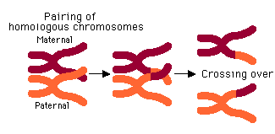
Meiosis – page 118 - 119
During interphase the DNA replicates forming two homologous chromosomes called a bivalent.
One of the chromosomes is maternal and one is paternal.
PROPHASE 1: The chromosomes condense and become visible.
The nucleolus disappears and the nuclear envelope breaks down.
The chromosomes in a bivalent may cross over at points called chiasmata where they may swap sections of DNA/alleles.

Slide 4
Meiosis – page 118 - 119
METAPHASE 1: The centrioles migrate to the poles and form the spindle which is made of microtubules.
The bivalents randomly line up on the equator.
The spindle fibres attach to them at their centromeres.
ANAPHASE 1: The homologous chromosomes of each bivalent are pulled apart by the spindle fibres, towards the poles.
The chiasmata uncross as they separate.

Slide 5
Meiosis – page 118 - 119
TELOPHASE 1: In animal cells the chromosomes will decondense a little and the nuclear envelope will reform.
Cytokinesis will occur and the cell will split.
However most plant cells progress straight to anaphase 2.
PROPHASE 2: Everything from now on happens in two cells.
The chromosomes recondense.
The centrioles replicate and the spindle starts to develop perpendicular to the previous division.
The nuclear envelope disintegrates.

Slide 6
Meiosis – page 118 - 119
METAPHASE 2: The chromosomes randomly line up on the equator.
They are attached to the spindle fibres at their centromeres.
ANAPHASE 2: The chromosomes are pulled apart by the spindle fibres.
The centromeres divide to allow the chromosomes to split.
The chromatids (now called chromosomes, just to confuse things) are pulled to the poles.

Slide 7
Meiosis – page 118 - 119
TELOPHASE 2: The chromosomes reach the poles and decondense.
The nuclear envelope reforms, forming four separate nuclei.
Cytokinesis may now occur and the cells divide.
Each cell has half the number of chromosomes as the original parent cell.

Slide 8
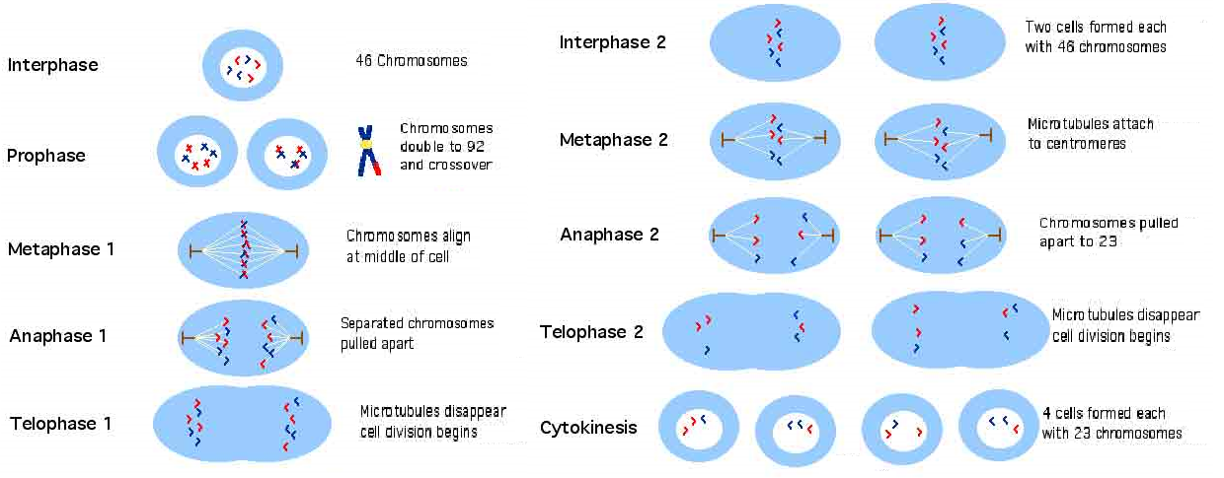
Meiosis – page 118 - 119
http://www.youtube.com/watch?v=kVMb4Js99tA&feature=related

Slide 9
How meiosis causes variation – pg 120
Each chromosome in a bivalent (homologous pair of chromosomes) contains the same genes at the same loci (places), however they may have different alleles of those genes.
An allele is a different version of the same gene.
When the chromosomes cross over at the chiasmata, they can break and re-join, producing a different combination of alleles on each chromatid.
This is called crossing over.

Slide 10
How meiosis causes variation – pg129
During metaphase 1 and 2 bivalents orientate themselves randomly on the equator, so the maternal and paternal chromosomes could be facing either pole.
Each bivalent behaves independently of the others.
This is called independent assortment.
This means that any combination of maternal or paternal chromosomes could end up in each gamete produced.
The number of different possible combinations of chromosomes in a gamete is 2²³!

Slide 11
Dihybrid inheritance ratios
NORMAL DIHYBRID INHERITANCE: 9:3:3:1
DOMINANT ANTAGONISTIC EPISTASIS: 12:3:1 or 13:3
RECESSIVE ANTAGONISTIC EPISTASIS: 9:3:4
COMPLIMENTARY EPISTASIS: 9:7
LINKAGE: 3:1
Sex linked traits are much more common in males, as they can only inherit one allele due to the Y chromosome.

Slide 12
Example 1: Normal Dihybrid Inheritance
Phenotypes of parents | Green hair, red eyes | Green hair, red eyes
Genotypes of parents | GgRr | GgRr
Gametes | GR gR Gr gr | GR gR Gr gr
 | GR | gR | Gr | gr
GR | GGRR | GgRR | GGRr | GgRr
gR | GgRR | ggRR | GgRr | ggRr
Gr | GGRr | GgRr | GGrr | Ggrr
gr | GgRr | ggRr | Ggrr | ggrr
Green hair, red eyes: 9
Normal hair, red eyes: 3
Green hair, normal eyes: 3
Normal hair, normal eyes: 1
9:3:3:1

Slide 13
Example 2: Recessive Antagonistic Epistasis pg 128
If both recessive alleles of a gene are present the other cannot be expressed
Phenotypes of parents | Purple | Purple
Genotypes of parents | AaBb | AaBb
Gametes | AB Ab aB ab | AB Ab aB ab
A- :Precursor to pigment, B/b: Purple/Pink pigment
 | AB | Ab | aB | ab
AB | AABB | AABb | AaBB | AaBb
Ab | AABb | AAbb | AaBb | Aabb
aB | AaBB | AaBb | aaBB | aaBb
ab | AaBb | Aabb | aaBb | aabb
Colour can only be expressed if A- is present
EXPLANATION: A- codes for a precursor and B/b code for different enzymes. If the precursor is not present (aa) then the enzymes will have nothing to work on.
Purple: 9
Pink: 3
White: 4
9:3:4

Slide 14
Example 3: Dominant Antagonistic Epistasis – pg 128
When the dominant allele of a gene is present the other cannot be expressed
Phenotypes of parents | White | White
Genotypes of parents | DdEe | DdEe
Gametes | DE De dE de | DE De dE de
 | DE | De | dE | de
DE | DDEE | DDEe | DdEE | DdEe
De | DDEe | Ddee | DdEe | Ddee
dE | DdEE | DdEe | ddEE | ddEe
de | DdEe | Ddee | ddEe | ddee
D- : No precursor
dd: Precursor
Ee: Yellow
ee: Green
EXPLANATION: dd codes for a precursor and E/e codes for different enzymes. If the precursor isn’t present (D-) then the enzymes have nothing to work on
White:12
Yellow:3
Green:1
12:3:1

Slide 15
Example 4: Complimentary Epistasis – pg 129
When the dominant allele from both genes have to be present to produce a characteristic
Phenotypes of parents | Purple | Purple
Genotypes of parents | CcRr | CcRr
Gametes | CR Cr cR cr | CR Cr cR cr
 | CR | Cr | cR | cr
CR | CCRR | CCRr | CcRR | CcRr
Cr | CCRr | CCrr | CcRr | Ccrr
cR | CcRR | CcRr | ccRR | ccRr
cr | CcRr | Ccrr | ccRr | ccrr
9:7
EXPLANATION: C- codes for a colourless precursor, R- codes for an enzyme that converts the precursor into purple pigment. If either are not present, the colour will remain white.
Purple: 9
White: 7

Slide 16
Example 5: Autosomal Linkage – pg 123
When two genes are found on the same chromosome and therefore inherited together (unless chiasmata form between)
Phenotypes of parents | Purple, long | Purple, long
Genotypes of parents | PpLl | PpLl
Gametes | PL pl | PL pl
 | PL | pl
PL | PPLL | PpLl
pl | PpLl | ppll
EXPLANATION: The genes for colour and length are on the same chromosome, so they will always be inherited together (unless crossing over occurs) in the same combination as in the parent cell.
Purple, long: 3
Red, short: 1
3:1

Slide 17
Example 6: Sex Linkage – pg 123/124
Where a gene is located on only one sex chromosome (usually X)
Phenotypes of parents | Normal Male | Carrier Female (haemophilia A)
Genotypes of parents | X^{H}Y | X^{H}X^{h}
Gametes | X^{H} Y | X^{H} X^{h}
 | X^{H} | Y
X^{H} | X^{H}X^{H} | X^{H}Y
X^{h} | X^{H}X^{h} | X^{h}Y
Female can’t inherit it
Male has 50% chance of inheriting it
EXPLANATION: If there is a recessive gene for a certain trait found on the X chromosome you are much more likely to inherit it being male because you only have one X chromosome (the other being Y), so you only need one recessive allele to inherit it

Slide 18
The Hardy-Weinberg Equations – pg 139
They allow us to calculate the frequency of certain alleles or combination of alleles within a population.
p = The frequency of the dominant allele (e.g. F)
q = The frequency of the recessive allele (e.g. f)
Both numbers are between 0 and 1
p + q = 1
p² + 2pq + q² = 1
p² represents the frequency of the genotype FF
2pq represents the frequency of the genotype Ff
q² represents the frequency of the genotype ff

Slide 19
Example
Equations:
p + q = 1
p² + 2pq + q² = 1
1 in 3300 babies are born with ff (cystic fibrosis) – what is the frequency of this?
Therefore q² = 1/3300 = 0.0003
q=0.017
p+q=1 Therefore 1-0.017=p=0.983
How many people are carries (genotype Ff)
use 2pq.
2*0.017*0.983 = 0.0334
So around 3.3 people out of 100 are carriers for cystic fibrosis.
Assumptions:
Large population
Random mating
No selective advantage for any genotype
No mutation, migration or genetic drift

Slide 20
Complete the Hardy Weinburg practice
There are three levels of difficulty

