Slide 1
Cellular Control
and
Genetics
15 - 21

Slide 2
Add the chi squared test here

Slide 3
Discontinuous variation
Normally controlled by just one gene, hence discontinuous characteristics are MONOGENIC
However discontinuous characteristics can sometimes be controlled by more than one gene. If this is the case they are likely to be EPISTATIC·
CODOMINANCE can also cause discontinuous variation—eg blood group.
The different alleles of a gene tend to have a much larger impact on the PHENOTYPE (characteristics) than those involved in continuous variation.
Phenotypes fall into discrete categories with no intermediate values, hence displayed on a bar chart

Slide 4
Continuous variation
Usually controlled by several genes - POLYGENIC
The genes tend to provide ‘additive’ components, i.e.: one gene adds to the effect of another.
The different alleles tend to have smaller effects on the PHENOTYPE.
POLYGENIC characteristics are influenced by the environment more than monogenic characteristics
A continuous range of values between two extremes, forming a normal distribution curve.

Slide 5
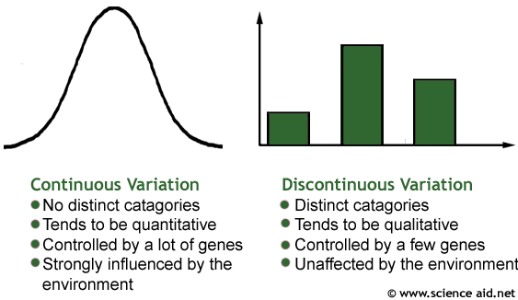
Variation

Slide 6
The effect of genes on environment and evolution
SELECTION PRESSURE: An environmental factor that confers greater chances of survival & hence reproduction for some members of a population and lower chances for others.
CARRYING CAPACITY: The maximum number of organisms in a population that the environment can sustain
ENVIRONMENTAL RESISTANCE: Factors that limit the growth of a population – such as food, light, water etc.

Slide 7
Stabilising selection
If the environment is relatively stable then the population will fluctuate about a mean point – e.g. environmental resistance lowers the population, leading to less competition, allowing the population to grow again etc.
If the environment is stable then STABILISING SELECTION occurs, the same genes/alleles are ‘selected for’ and the gene pool of the population remains roughly the same.

Slide 8
Directional selection
If the environment changes – e.g. a new predator is introduced – DIRECTIONAL SELECTION occurs where certain genes confer advantages to the population and so have a greater chance of being inherited than other genes which may now confer a disadvantage.
Occurs when a new selection pressure is introduced
The advantageous genes gradually become more common in the population and so the population gradually evolves over time.

Slide 9
Genetic Drift
Random fluctuations can occur in allele frequency within a population – purely by chance. This is called GENETIC DRIFT.
It occurs simply because of the randomness of reproduction.
In extreme cases, usually only in small populations, an allele may be eradicated from a population entirely.

Slide 10
Genetic Drift Example
Two heterozygous parents both with the genotype Ff can produce offspring with 3 genotypes:
FF, Ff and ff
The allele frequency within the population will change slightly depending on the offspring they have.

Slide 11
Speciation
Large populations can be split into sub-groups by a geographical, seasonal (e.g. change of climate) or reproductive barrier.
The selection pressures may be different in each population or genetic drift may occur, changing the gene pool of each population, until eventually the two sub-groups may not be able to breed together, at which point they are classified as separate species.

Slide 12
Classification of species
THE BIOLOGICAL SPECIES CONCEPT: A group of similar organisms that can interbreed to produce fertile offspring.
THE PHYLOGENIC SPECIES CONCEPT: A group of organisms that have similar morphology, physiology, embryology and behaviour and occupy the same ‘ecological niche’.
Two groups of organisms that look very similar but live in different parts of the world can also be classified as different species.
Useful when dealing with extinct species or bacteria.

Slide 13
Cladistics
CLADISTICS: The classification of species based on evolutionary ancestry (using DNA techniques like the one below)
It is partly worked out by comparing HAPLOTYPES – sequences of DNA.
Any group of organisms that have similar haplotypes is called a CLADE.
A CLADE is a MONOPHYLETIC GROUP as it includes ancestral organisms and their descendants (one phylum).

Slide 14
Cladistics
Focuses on evolution rather than similarities between species
Uses a lot of molecular analysis (most importantly DNA & RNA sequencing)
Uses computers to produce ‘cladograms’ that represent the evolutionary tree of life
Makes no distinction between extinct species and species still alive today.

Slide 15
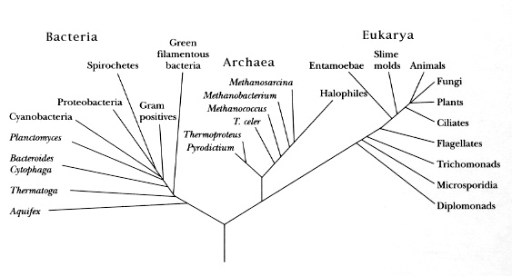
The evolutionary tree of life

Slide 16
Natural and artificial selection
In natural selection, selection pressures ‘select’ the alleles, whereas in artificial selection, humans select the alleles for the best characteristics.

Slide 17
Artificial Selection – Bread Wheat
Modern wheat has a genome A^{u}A^{u}BBDD
The A^{u}A^{u} comes from a wild wheat species with 14 chromosomes in each cell
The BB comes from another wild wheat species which also has 14 chromosomes in each cell
The DD comes from a wild goat grass species which also has 14 chromosomes in each cell.
The resulting wheat is a hybrid of all these species and hence has 42 chromosomes in each cell.
The three species have been bred together in the past over time to produce the modern variety.

